Slide 1

CNENGR506
Intelligent System Control

Slide 2







Syllabus
3
System
Identification
Concept of Feedback, Terminology and Objectives of Control
1
2
Optimal control
Introduction to “Modern Control”
Robust control
6
Transfer Functions represented using the
Theory
5
Backward Shift operator
State variable
Stochastic control
feedback using non-minimal state space models
pole assignment and 4
Block diagram analysis,
discrete-time PI control
Feed-forward control
CORE TOPIC
Multivariable & Non-linear

Slide 3
ENGR406 (506)
Intelligent System Control
Contents
Part 1 – Terminology and Objectives of Control
Part 2 – Discrete–Time Transfer Function Models
Part 3 – System Identification
Part 4 – Discrete–Time Control & Pole Assignment
Part 5 – State Variable Feedback
Part 6 – Additional Topics & Case Studies

Slide 4
Part 4 – Discrete–Time Control & Pole Assignment
Contents
Section 4.1 – Proportional Action
Section 4.2 – Integral Action
Section 4.3 – Motorway Traffic
Section 4.4 – Pole Assignment

Slide 5
Design Process
Identification of data-based model
Control model used to directly estimate the parameters (or gains) of the controller
Simulation model
(if available) used to evaluate the controller before implementation
Estimation of control algorithm
Evaluation by simulation
Implementation

Slide 6
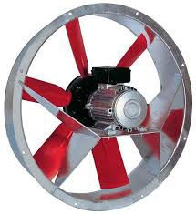
Example – Axial Fan
u(k )
voltage
y(k )
airflow

Slide 7
Example – Axial Fan Model
u(k )
y(k )
1.6z⁻¹
voltage
1− 0.8z⁻¹
airflow

Slide 8
Proportional Control
u(k )
_{bz}−1
1 + az⁻¹
y(k)
+
y_{d} (k) k_{p}
Set point, i.e. desired ⁻
ventilation rate
Control Algorithm:
u(k ) = k_{p} ( y_{d} (k ) − y(k ))

Slide 9
Block Diagram Analysis – Series Rule
e(k )
y(k )
G₁
G₂
e(k )
y(k )
G₁G₂

Slide 10
Block Diagram Analysis – Unity Negative Feedback
r(k ) ₊
y(k )
G₁
−
G₁
y(k ) =
r(k )
1
1+ G₁

Slide 11
Closed Loop Transfer Function
u(k )
_{bz}−1
1 + az⁻¹
y(k)
+
y_{d} (k) k_{p}
-
⎛
_{bz}−1
⎞
k
p ⎜
⎝
⎟
⎠
1+ az
−1
k bz⁻¹
y(k ) =
y (k ) =
p
y (k )
⎛
_{bz}−1
⎞
d
( )
−1
d
1+ a + k b z
1+ k
p ⎜
⎝
⎟
⎠
p
1+ az
−1
Poles of the plant: –a Control system: –a – k_{p}b
11

Slide 12
Steady State Gain
u(k )
_{bz}−1
1 + az⁻¹
y(k)
+
y_{d} (k) k_{p}
-
k_{p}b
y(k → ∞) =
y
1+ a + k b
d
p
No steady state tracking

Slide 13
Closed Loop Response
command
1
0.8
output
0.6
0.4
0.2
control input
0
0
5
10
sample no.
15
20

Slide 14
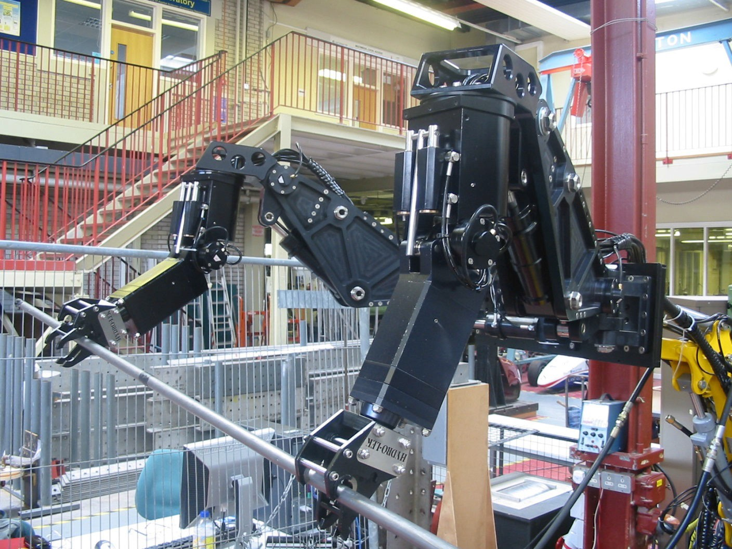
Hydraulic Manipulators
a₁ = −1

Slide 15
Part 4 – Discrete–Time Control & Pole Assignment
Contents
Section 4.1 – Proportional Action
Section 4.2 – Integral Action
Section 4.3 – Motorway Traffic
Section 4.4 – Pole Assignment

Slide 16
Example – Axial Fan
u(k )
y(k )
1.6z⁻¹
voltage
1− 0.8z⁻¹
airflow

Slide 17
Integral Control
Control system block diagram:
+
k_{I} 1 − z⁻¹ | u(k)
_{bz}−1
y(k )
y_{d} (k )
1 + az
−1
-
Control algorithm in difference equation form:
u(k ) = u(k −1) + k_{I} ( y_{d} (k ) − y(k ))
−1
( )
u(k ) = z u(k ) + k
y (k ) − y(k )
I d
( )
(
)
Control algorithm in TF form:
−1
1− z u(k ) = k
y (k ) − y(k )
k_{I}
I
d
u(k ) =
₁ ( y_{d} (k ) − y(k ))
1− z⁻

Slide 18
Transfer Function form to Difference Equation
+
k_{I} 1 − z⁻¹ | u(k)
_{bz}−1
y(k )
y_{d} (k )
1 + az
−1
-
k_{I}
u(k ) =
₁ ( y_{d} (k ) − y(k ))
Control algorithm in TF form
1− z⁻
( )
(
)
Control algorithm in difference equation form
−1
1− z u(k ) = k
y (k ) − y(k )
I d
−1
( )
u(k ) − z u(k ) = k
y (k ) − y(k )
I d
u(k ) = u(k −1) + k_{I} ( y_{d} (k ) − y(k ))

Slide 19
Integral Control Sums the Error Signal
u(k ) = u(k −1) + k_{I} ( y_{d} (k ) − y(k ))
u(k −1) = u(k − 2) + k_{I} ( y_{d} (k −1) − y(k −1))
u(k − 2) = u(k − 3) + k_{I} ( y_{d} (k − 2) − y(k − 2))
u(k −1) = u(k − 3) + k_{I} ( y_{d} (k − 2) − y(k − 2)) + k_{I} ( y_{d} (k −1) − y(k −1))
u(k ) = u(k − 3) + k_{I} ( y_{d} (k − 2) − y(k − 2))
+ k_{I} ( y_{d} (k −1) − y(k −1)) + k_{I} ( y_{d} (k ) − y(k ))

Slide 20
In a moment, standard algebra applies…
Multiply brackets out in the usual way
Powers sum in the usual way
( )(
−1 ₎
−1
−1 −1 −1 −1
1− z 1+ a₁ z
= 1+ a₁ z − z − a₁ z z
−1 −1
−2
= 1+ a₁ z − z − a₁ z

Slide 21
Integral Control Closed Loop Transfer Function
+
k_{I} 1 − z⁻¹ | u(k)
bz⁻¹
y(k )
y_{d} (k )
1 + az
−1
-
⎛ k ⎞⎛
_{bz}−1
⎞
⎜
I
1− z
⎟⎜
⎟
⎠
k bz⁻¹
⎝
−1
⎠⎝
1+ az
−1
y(k ) =
y (k )
=
( )(
I
)
y (k )
d
−1
−1
−1
d
⎛ k ⎞⎛
_{bz}−1
⎞
1− z 1+ az + k bz
1+
⎜
I
1− z
⎟⎜
⎟
⎠
I
⎝
−1
⎠⎝
1+ az
−1
k bz⁻¹
k bz⁻¹
y(k ) =
I
y (k ) =
I
y (k )
1+ az⁻¹ − z⁻¹ − az⁻² + k bz⁻¹
d
(
)
−1
−2
d
I
1+ a −1+ k b z − az
I

Slide 22
Integral Control Steady State Gain
+
k_{I} 1 − z⁻¹ | u(k)
_{bz}−1
y(k )
y_{d} (k )
1 + az
−1
-
⎛ k ⎞⎛
_{bz}−1
⎞
⎜
I
1− z
⎟⎜
⎟
⎠
⎝
−1
⎠⎝
1+ az
−1
k bz⁻¹
y(k ) =
y (k ) =
I
y (k )
_{bz}−1
d
( )
−1
−2
d
⎛ k ⎞⎛
⎞
1+ k b + a −1 z − az
1+
⎜
I
1− z
⎟⎜
⎟
⎠
I
⎝
−1
⎠⎝
1+ az
−1
k b
y(k → ∞) =
I
y_{d} = y_{d}
1+ k_{I}b + a −1− a
Type 1 servomechanism behaviour (steady state tracking of set point)
11

Slide 23
Integral Control Illustrative Time Response
command
1
0.8
output
0.6
0.4
0.2
control input
0
0
5
10
sample no.
15
20

Slide 24
Part 4 – Discrete–Time Control & Pole Assignment
Contents
Section 4.1 – Proportional Action
Section 4.2 – Integral Action
Section 4.3 – Motorway Traffic
Section 4.4 – Pole Assignment

Slide 25
Ramp Metering Control on Motorways

Slide 26
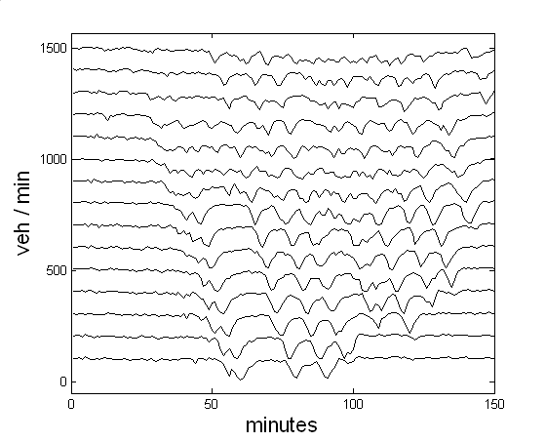
Utrecht to Amsterdam A2 Motorway

Slide 27
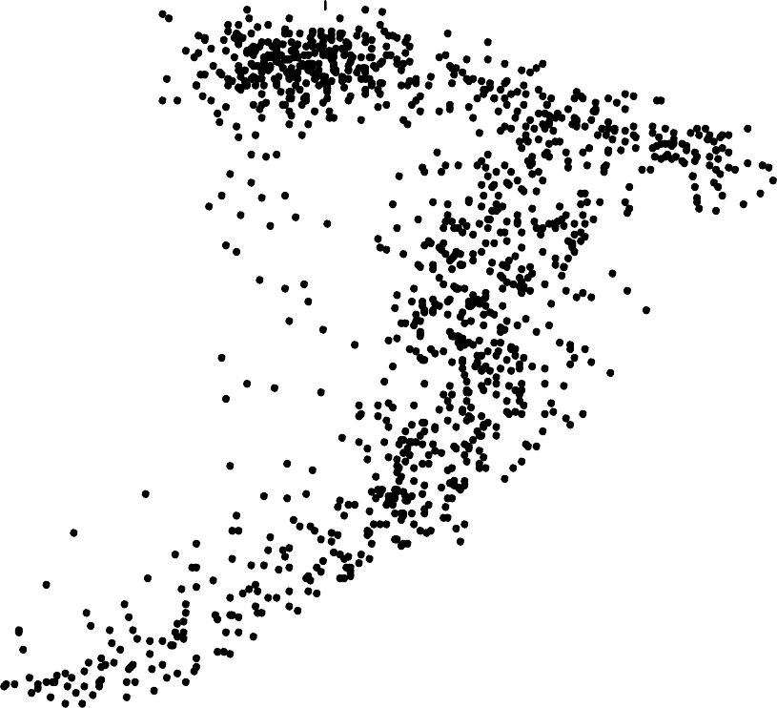
M3 Motorway near Southampton
120
100
Velocity (km/hour)
80
60
40
20
0
0
20
40
60
80
100
120
140
Flow (veh/min)

Slide 28
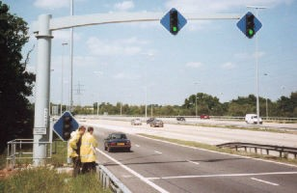
ALINEA Ramp Metering Algorithm
Motorway access control uses traffic lights on the entrance ramps
Vehicles temporarily delayed at the lights to avoid flow breakdown on motorway main carriageway
The industry standard algorithm (ALINEA) was based on simple integral control

Slide 29
Part 4 – Discrete–Time Control & Pole Assignment
Contents
Section 4.1 – Proportional Action
Section 4.2 – Integral Action
Section 4.3 – Motorway Traffic
Section 4.4 – Pole Assignment

Slide 30
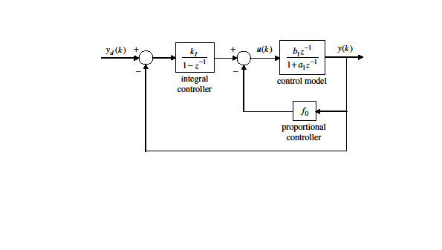
Proportional-Integral (PI) Control
k_{I}
₁ (y_{d} (k ) − y(k ))− f₀ y(k )
u(k ) =
1− z⁻

Slide 31
Exercise 1
Prove these are equivalent forms of the same PI control algorithm
k_{I}
₁ (y_{d} (k ) − y(k ))− f₀ y(k )
u(k ) =
1− z⁻
u(k) = u(k −1) + k_{I} ( y_{d} (k ) − y(k )) − f₀ ( y(k ) − y(k −1))

Slide 32
Exercise 2
Use the rules of block diagram analysis (or otherwise) to show that the closed-loop Transfer Function is as follows
k b z⁻¹
y(k ) =
I 1
y_{d} (k )
−1
−2
1+ ( f₀b₁ + a₁ −1+ k_{I} b₁)z + (−a₁ − f₀b₁)z
Hint: simplify the inner feedback loop first i.e. the model and the proportional gain

Slide 33
Steady State Gain and Characteristic Equation
k b z⁻¹
y(k) =
I 1
y_{d} (k )
1+ ( f₀b₁ + a₁ −1+ k_{I} b₁)z
−1
+ (−a₁ − f₀b₁)z
−2
k b
y(k → ∞) =
I 1
y_{d} = y_{d}
1+ f₀b₁ + a₁ −1+ k_{I} b₁ − a₁ − f₀b₁
2
z + ( f₀b₁ + a₁ −1+ k_{I} b₁)z + (−a₁ − f₀b₁) = 0

Slide 34
Example – Axial Fan
u(k )
y(k )
1.6z⁻¹
voltage
1− 0.8z⁻¹
airflow
a₁ = −0.8
b₁ = 1.6

Slide 35
Pole Assignment
Pole assignment is a method for determining the control gains
In this example, we will apply the method to estimate gains for the PI controller i.e. to determine the proportional and integral gains
First step, determine the closed-loop Transfer Function and write down the characteristic equation:
2
z + ( f₀b₁ + a₁ −1+ k_{I} b₁)z + (−a₁ − f₀b₁) = 0

Slide 36
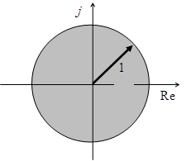
Example 1 – Deadbeat
2
z + ( f₀b₁ + a₁ −1+ k_{I} b₁)z + (−a₁ − f₀b₁) = 0
p₁ = p₂ = 0
D(z) = ( z − 0)( z − 0) = z² = 0
( f₀b₁ + a₁ −1+ k_{I} b₁) = 0 ; (−a₁ − f₀b₁) = 0
f₀ = − a₁ b₁ f₀ = 0.5
k_{I} = 1 b₁
k_{I} = 0.625
10

Slide 37
Deadbeat Time Response
0.625
₁ ( y_{d} (k ) − y(k )) − 0.5 y(k )
u(k ) =
1− z⁻
command
1
What are the disadvantages of deadbeat control?
0.8
output
0.6
0.4
0.2
control input
0
0
5
10
sample no.
15
20

Slide 38
Example 2 – Complex Poles
2
z + ( f₀b₁ + a₁ −1+ k_{I} b₁)z + (−a₁ − f₀b₁) = 0
p_{1,2} = 0.6 ± 0.3 j
D(z) = ( z − 0.6 + 0.3 j )( z − 0.6 − 0.3 j ) = z² −1.2z + 0.45 = 0
( f₀b₁ + a₁ −1+ k_{I} b₁) = −1.2 ; (−a₁ − f₀b₁) = 0.45
f₀ = 0.2188 k_{I} = 0.1563
12

Slide 39
Complex Poles Time Response
0.1563
₁ ( y_{d} (k ) − y(k )) − 0.2188 y(k )
u(k ) =
1− z⁻
command
1
This design method is called pole placement or pole assignment
0.8
output
0.6
0.4
0.2
control input
0
0
5
10
sample no.
15
20

Slide 40
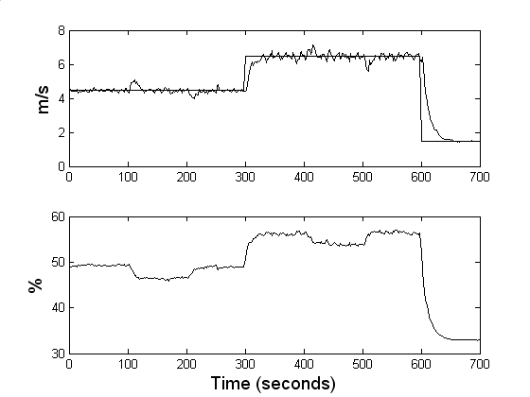
Laboratory Results

Slide 41
Recap
For a first order open loop system, with 1 numerator parameter and 1 time delay …
We obtained a 2nd order closed loop characteristic equation and compared it with the 2nd order desired characteristic equation
Two equations, 2 unknown control gains (note that a1 and
b1 have already been estimated)
The closed loop system is said to be controllable
i.e. we can place the poles at arbitrary positions on the complex z-plane

Slide 42
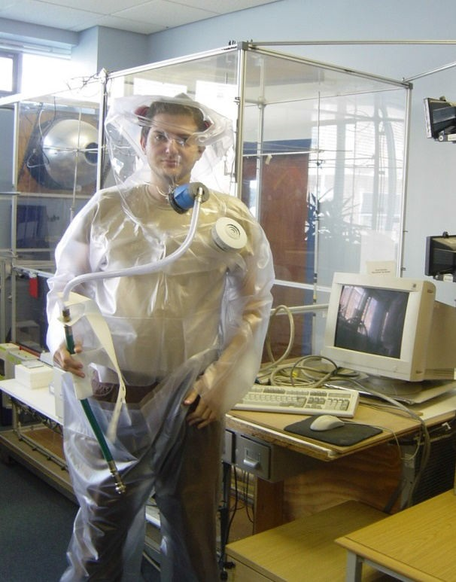
Time Delays
u(k )
y(k )
0.027z⁻²
voltage
1− 0.743z⁻¹
airflow
y(k ) = 0.743y(k −1) + 0.027u(k − 2)
0.027z⁻²
y(k ) = u(k )
1− 0.743z⁻¹

Slide 43
Third Order Closed Loop Transfer Function
u(k )
y(k )
0.027z⁻²
voltage
1− 0.743z⁻¹
airflow
0.027k z⁻²
y(k ) =
I
y_{d} (k )
1−1.743z⁻¹ + (0.743 + 0.027 f₀ + 0.027k_{I} ) z⁻² − 0.027 f₀ z⁻³

Slide 44
Higher Order Systems
u_{k}
b z⁻³ + b z⁻⁴ + b z⁻⁵
y_{k}
3 4 5
−1
−2
−3
pitch angle
1+ a₁z + a₂ z
a₃ z
torque
wind turbine

Slide 45
Limitations of PI control
In the case of time delays and/or higher order systems, the order of the closed-loop transfer function is increased, but there are still only 2 control gains
We cannot assign the closed loop poles to arbitrary positions on the complex z-plane i.e. the closed loop system is uncontrollable
The solution is to introduce additional feedback terms,
i.e. more control gains
State variable feedback provides one approach to this
19

